Slide 1
Types of Recursions

Slide 2
Types of Recursions:
Recursion are mainly of two types depending on whether a function calls itself from within itself or more than one function call one another mutually.
1. Direct recursion
2. Indirect recursion.

Slide 3
Direct Recursion
Direct Recursion: A method is directly recursive if it contains an explicit call to itself.
long factorial (int x) {
if (x == 0)
return 1;
else
return x * factorial (x – 1);
}

Slide 4
Indirect Recursion
Indirect Recursion: A method x is indirectly recursive if it contains a call to another method which in turn calls x. They are also known as mutually recursive methods.
bool isEven(int n)
{
if (n==0)
return true;
else
return(isOdd(n-1));
}
bool isOdd(int n) {
return (!isEven(n));
}

Slide 5
Direct Recursion
It is further divided into four types:
1.Tail Recursion: If a recursive function calling itself and that recursive call is the last statement in the function then it’s known as Tail Recursion. After that call the recursive function performs nothing. The function has to process or perform any operation at the time of calling and it does nothing at returning time.

Slide 6
Direct Recursion
It is further divided into four types:
1.Tail Recursion: If a recursive function calling itself and that recursive call is the last statement in the function then it’s known as Tail Recursion. After that call the recursive function performs nothing. The function has to process or perform any operation at the time of calling and it does nothing at returning time.
void fun(int n)
{
if (n > 0) {
cout << n << " ";
// Last statement in the function
fun(n - 1);
}
}

Slide 7
gcd((12,16)
gcd(17,11)
gcd(2,2)
gcd(0,5)
int gcd(int A, int B)
{
if(B==0)
return A;
return gcd(B, A%B);
}

Slide 8
Direct Recursion
2.Head Recursion: If a recursive function calling itself and that recursive call is the first statement in the function then it’s known as Head Recursion. There’s no statement, no operation before the call. The function doesn’t have to process or perform any operation at the time of calling and all operations are done at returning time.

Slide 9
Direct Recursion
2.Head Recursion: If a recursive function calling itself and that recursive call is the first statement in the function then it’s known as Head Recursion. There’s no statement, no operation before the call. The function doesn’t have to process or perform any operation at the time of calling and all operations are done at returning time.
void fun(int n)
{
if (n > 0) {
// First statement in the function
fun(n - 1);
cout << " "<< n;
}
}

Slide 10
fact(5)
fact(7)
int fact(int A)
{
if(A==1)
return A;
return A*fact(A-1);
}

Slide 11
Direct Recursion
3.Tree Recursion: To understand Tree Recursion let’s first understand Linear Recursion. If a recursive function calling itself for one time then it’s known as Linear Recursion. Otherwise if a recursive function calling itself for more than one time then it’s known as Tree Recursion.

Slide 12
Direct Recursion
It is further divided into four types:
3.Tree Recursion: To understand Tree Recursion let’s first understand Linear Recursion. If a recursive function calling itself for one time then it’s known as Linear Recursion. Otherwise if a recursive function calling itself for more than one time then it’s known as Tree Recursion.
void fun(int n)
{
if (n > 0)
{
cout << " " << n;
// Calling once
fun(n - 1);
// Calling twice
fun(n - 2);
}
}

Slide 13
fib(3)
fib(5)
int fib(int n)
{
if (n < 2)
return (n);
else
return (fib(n-1) + fib(n-2));
}

Slide 14
Direct Recursion
4.Nested Recursion: In this recursion, a recursive function will pass the parameter as a recursive call. That means “recursion inside recursion”. Let see the example to understand this recursion.

Slide 15
Direct Recursion
4.Nested Recursion: In this recursion, a recursive function will pass the parameter as a recursive call. That means “recursion inside recursion”. Let see the example to understand this recursion.
int fun(int n)
{
if (n > 100)
return n - 10;
return fun(fun(n + 11));
}

Slide 16
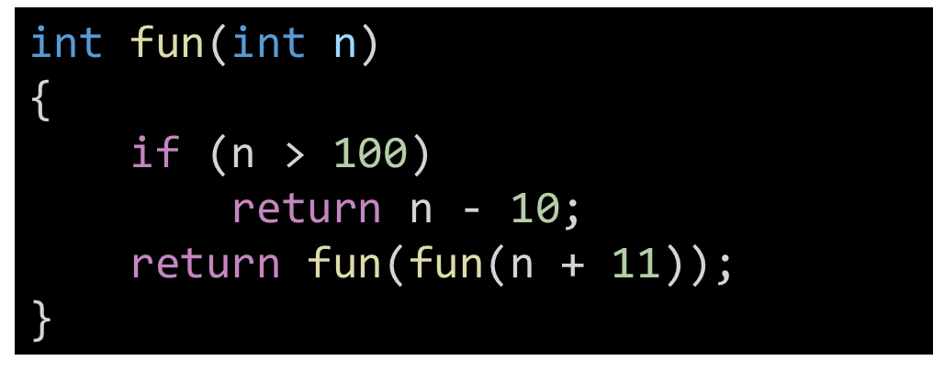
Fun(98)

Slide 17
Examples:
The Tribonacci sequence Tn is defined as follows:
T0 = 0, T1 = 1, T2 = 1, and Tn+3 = Tn + Tn+1 + Tn+2 for n >= 0.
Given n, return the value of Tn.
Input: n = 4
Output: 4
Input: n = 25
Output: 1389537

Slide 18
Examples:
Write a C Program to find power of a number using recursion.
Given a and b, return the value of a^b.
Input: n = 2,3
Output: 8
Input: n = 5,6
Output: 15625

Slide 19
Towers of Hanoi Problem
1
2
3
4
5
A
B
C

Slide 20
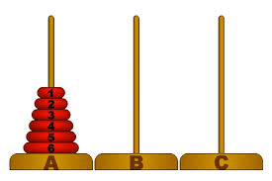
Towers of Hanoi Problem
The problem statement
Initially all the disks are stacked on the A pole.
Required to transfer all the disks to the C pole.
Only one disk can be moved at a time.
A larger disk cannot be placed on a smaller disk.
C pole is used for temporary storage of disks.

Slide 21
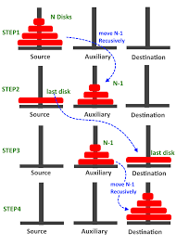
Towers of Hanoi Problem
Recursive statement of the general problem of n disks
Step 1:
Move the top (n-1) disks from A to B
Step 2:
Move the largest disk from A to C.
Step 3:
Move the (n-1) disks from B to C.

Slide 22
Towers of Hanoi Problem
#include <stdio.h>
void move(int n, char A, char B, char C);
int main()
{
int n; /* Number of disks */
scanf (“%d”, &n);
move (n, ‘A’, ‘B’, ‘C’);
return 0;
}
void move (int n, char A, char B, char C)
{
if (n > 0) {
move (n-1, A, C, B);
printf (“Move disk %d from %c to %c \n”, n, A, C);
move (n-1, B, C, A);
}
return;
}

Slide 23
Towers of Hanoi – Execution
3
Move disk 1 from A to C
Move disk 2 from A to B
Move disk 1 from C to B
Move disk 3 from A to C
Move disk 1 from B to A
Move disk 2 from B to C
Move disk 1 from A to C
4
Move disk 1 from A to B
Move disk 2 from A to C
Move disk 1 from B to R
Move disk 3 from A to B
Move disk 1 from C to L
Move disk 2 from C to B
Move disk 1 from A to B
Move disk 4 from A to C
Move disk 1 from B to C
Move disk 2 from B to A
Move disk 1 from C to A
Move disk 3 from B to C
Move disk 1 from A to B
Move disk 2 from A to C
Move disk 1 from B to C
5
Move disk 1 from A to C
Move disk 2 from A to B
Move disk 1 from C to B
Move disk 3 from A to C
Move disk 1 from B to A
Move disk 2 from B to C
Move disk 1 from A to C
Move disk 4 from A to B
Move disk 1 from C to B
Move disk 2 from C to A
Move disk 1 from B to A
Move disk 3 from C to B
Move disk 1 from A to C
Move disk 2 from A to B
Move disk 1 from C to B
Move disk 5 from A to C
Move disk 1 from B to A
Move disk 2 from B to C
Move disk 1 from A to C
Move disk 3 from B to A
Move disk 1 from C to B
Move disk 2 from C to A
Move disk 1 from B to A
Move disk 4 from B to C
Move disk 1 from A to C
Move disk 2 from A to B
Move disk 1 from C to B
Move disk 3 from A to C
Move disk 1 from B to A
Move disk 2 from B to C
Move disk 1 from A to C
How many moves are
required for n disks?

